Slide 1
RBK vehicles
made by Jasser Youssef and Walid Laffet

Slide 2
PRESENTATION
Our project is cars site that help to find the cars models It helps to find all the models of a brand or a specific model with the price To find the car you can use the search button or by click

Slide 3
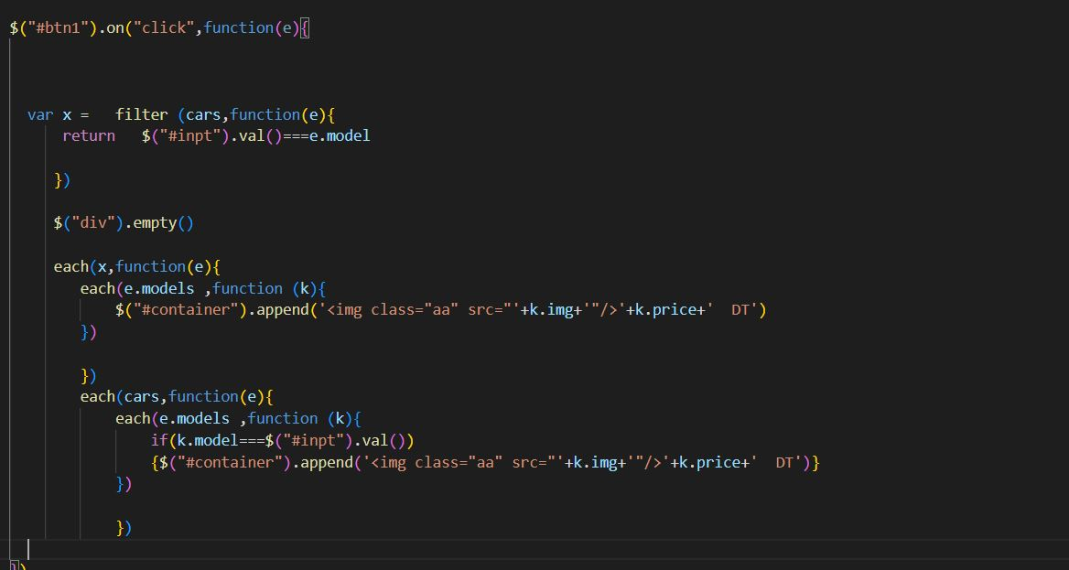
To make the search work we had to write this code

Slide 4
HOW IT WORKS
we used the input value and compared to every element (which is an object ) model , if they match we use empty() and reappand all the models inside that brand or reappend only a specific model

Slide 5
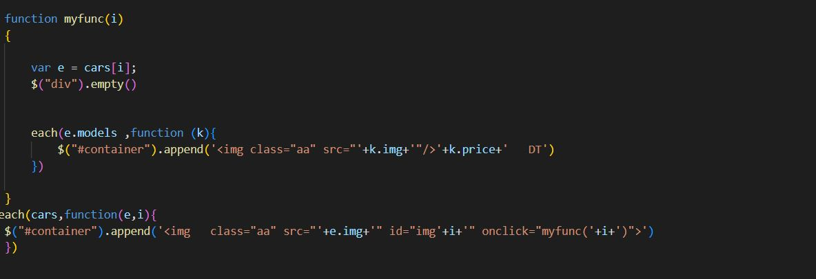
to make the click on image works we had to write this code

Slide 6
HOW IT WORKS
when we append our image in the beginning we gave each one on id that corresponds to the (i) of the loop , and we gave a function that take that (i), so when we click that function wil do her job. the function will loop inside the brand with that index and reappend the models inside it

Slide 7
CONCLUSION
this site is a gallery of cars that can help you to make decision and choose the car you need

Slide 8
THANK YOU

